Slide 1


VIDYAVARDHAKA COLLEGE OF ENGINEERING
NAME: SYEDA UMME AFSHAN
TOPIC: COLLEGE ADMISSION AGENT
Agentic AI

Slide 2
PROBLEM STATEMENT
PROPOSED SYSTEM
SYSTEM DEVELOPMENT APPROACH
ALGORITHM AND DEPLOYMENT
RESULT
CONCLUSION
FEATURE SCOPE
REFERENCES

Slide 3
PROBLEM STATEMENT
In India, the AYUSH sector is a growing field offering undergraduate and postgraduate courses in Ayurveda, Yoga, Naturopathy, Unani, Siddha, and Homeopathy. However, students and parents often face confusion and a lack of accessible, personalized, and up-to-date information about admission processes, eligibility criteria, available institutions, counseling rounds, and cut-off scores.
Navigating the AYUSH (Ayurveda, Yoga & Naturopathy, Unani, Siddha, and Homeopathy) college admission process in India is complex due to scattered information, changing policies, and varying state-level procedures. Students often struggle with understanding eligibility, selecting suitable colleges, and tracking counseling updates. There is a lack of personalized, real-time guidance tailored to the unique needs of AYUSH aspirants. An Agentic AI-powered admission assistant can bridge this gap by autonomously guiding students through the entire process—from eligibility checks to college selection—acting like a knowledgeable and proactive digital counselor.

Slide 4
PROPOSED SOLUTION
To address the challenges in AYUSH admissions, we propose an Agentic AI-based virtual assistant that autonomously guides students through the entire admission journey. This AI agent will analyze students' academic data and NEET scores to assess eligibility, recommend best-fit colleges, and simulate admission scenarios using historical cut-off trends. It will actively monitor and update users on important counseling dates, seat allotments, and documentation requirements. The agent will also support multilingual interaction, enabling broader accessibility. By functioning proactively and independently, it will offer personalized, real-time support, reducing dependence on third-party consultants.

Slide 5
SYSTEM APPROACH
The system begins by collecting essential student information such as NEET scores, category, preferred AYUSH course, state, and budget. It then checks the student’s eligibility based on the latest admission rules for both all-India and state quotas. Using past cut-off data and student preferences, the AI recommends suitable colleges and predicts admission chances. The agent continuously monitors counseling schedules and seat allotments, providing real-time updates and reminders. It guides students step-by-step through application procedures like registration, choice filling, and document submission. Finally, the AI offers 24/7 conversational support in simple and regional languages to assist students throughout the entire admission process.

Slide 6
ALGORITHM AND DEPLOYMENT
The system collects key student data—NEET scores, preferences, and eligibility criteria—and cross-references this with real-time AYUSH admission databases. It leverages machine learning to recommend and rank colleges based on past trends and personalized profiles, while simulating possible admission outcomes. Continuous monitoring of official updates ensures timely alerts and proactive guidance throughout the application process. The AI backend is containerized and deployed on IBM Cloud Kubernetes or Cloud Foundry for scalability and reliability. Data storage uses IBM Cloudant or PostgreSQL, while IBM Watson services power conversational AI features. The frontend runs on IBM Cloud storage, with comprehensive monitoring tools ensuring seamless performance and rapid issue resolution.

Slide 7
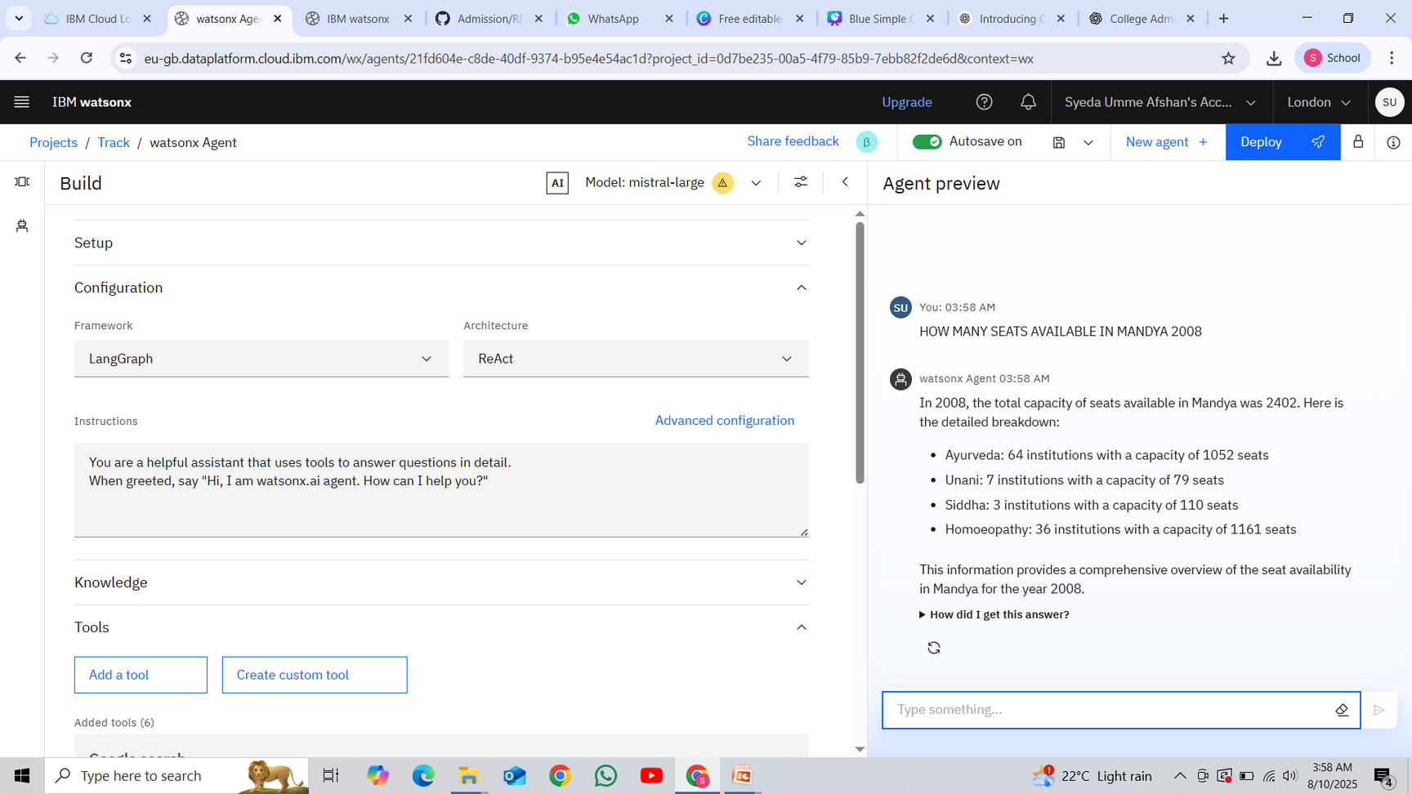
RESULT

Slide 8
CONCLUSION
By leveraging Agentic AI and IBM Cloud, the system offers personalized, real-time guidance for AYUSH admissions, simplifying a complex process. This solution empowers students to make informed decisions with ease and confidence.

Slide 9
FEATURE SCOPE
The system will cover student profile management, eligibility checks, and personalized college recommendations based on real-time data and historical trends. It will provide timely notifications for counseling events, seat allotments, and deadlines. The AI agent will support step-by-step application guidance and document management, along with 24/7 multilingual conversational support. Future enhancements may include integration with official admission portals, AI-driven career counseling, and mobile app support for greater accessibility.

Slide 10
REFERENCES
Kumar and Sharma (2022) discuss the challenges and opportunities in AI-based college admission systems in their article published in the International Journal of Educational Technology.
Singh, Patel, and Gupta (2021) review the use of Agentic AI for autonomous student counseling in the Journal of Artificial Intelligence Research.
Zhang and Lee (2020) explore machine learning approaches for college admission prediction in the proceedings of the IEEE International Conference on Educational Data Mining.
Chen and Wang (2019) focus on the design and evaluation of chatbot systems for student counseling, published in the Journal of Computer Assisted Learning.
Rodriguez and Kim (2023) present insights on implementing autonomous AI agents for education guidance in the journal AI & Society.

Slide 11
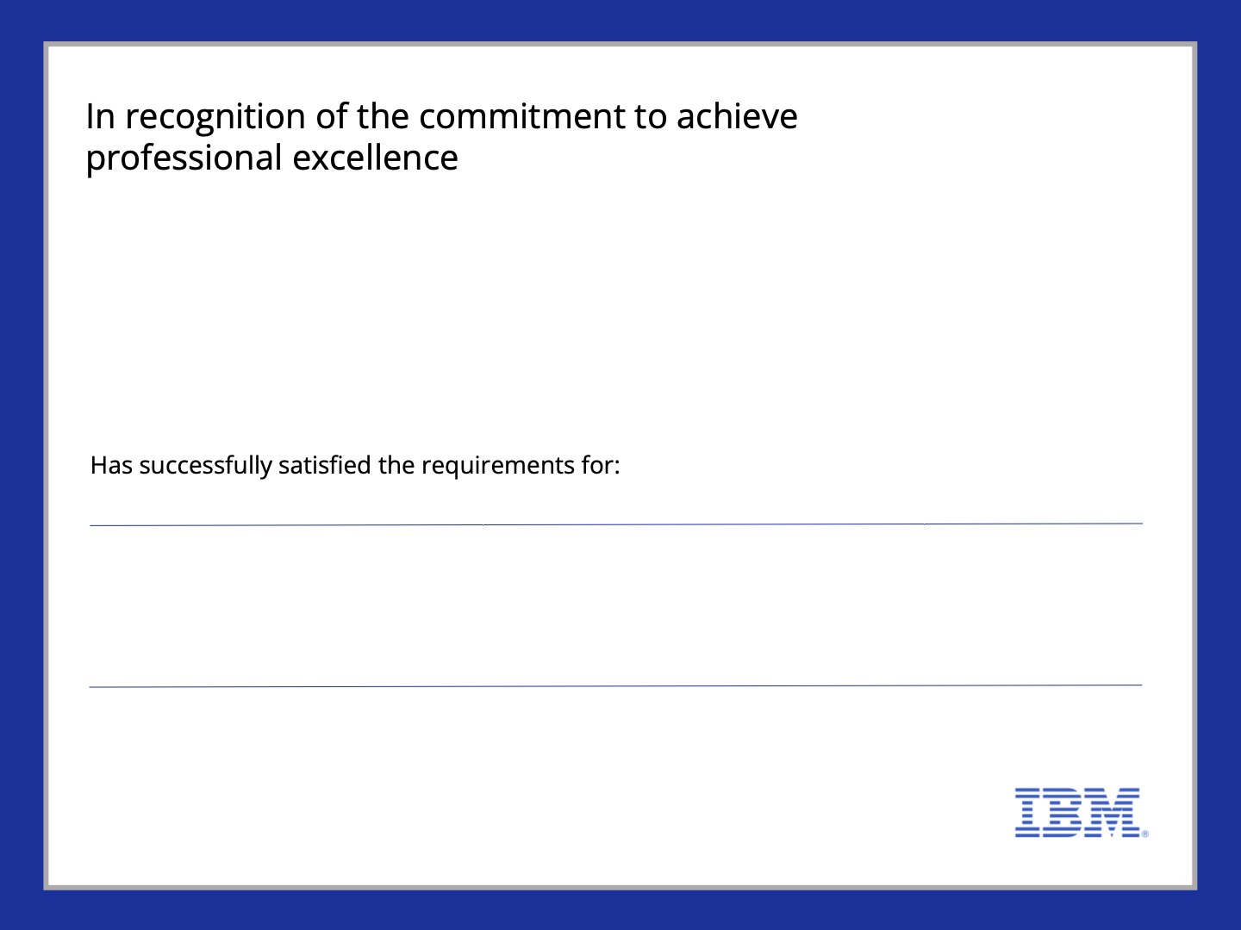


Syeda Umme Afshan
Journey to Cloud: Envisioning Your Solution
Issued on:Jul21, 2025
Issued by:IBM SkillsBuild
Verify:
https://www.credly.com/badges/506205b6-3fe7-4a5c-8f1d-5ddbe0d20bad

Slide 12
GITHUB LINK: https://github.com/Zaishan04/Admission/blob/main/Track.ipynb
THANK
YOU

